Slide 1

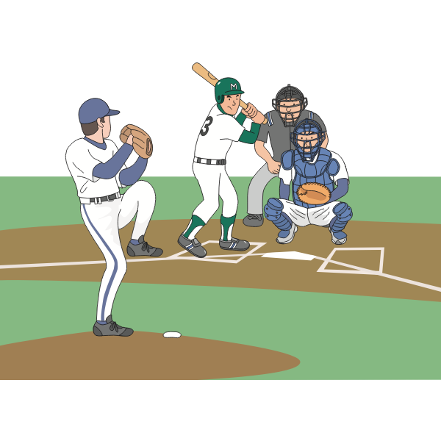










ATTRACTIONS
Forest Creek Golf Club
99 Twin Ridge Parkway
Round Rock, TX 78664
512.388.2874
https://www.forestcreek.com
RR Premium Outlets
4401 IH-35
Round Rock, TX 78664
512.863.6688
https://www.premiumoutlets.com/outlet/round-rock
Dell Diamond
3400 E Palm Valley Blvd
Round Rock, TX 78664
512.255.2255
https://www.milb.com/round-rock
World Famous!
Kalahari
America’s Largest Indoor Waterpark
Tom Foolery Fun & Games
3001 Kalahari Blvd,
Round Rock, TX 78665
512 651 1000
https://www.kalahariresorts.com/texas/
Uncle Buck’s Fishbowl and Grill
200 Bass Pro Drive
Round Rock, TX 78665
512.876.2600
https://www.unclebucksfishbowlandgrill.com
Round Rock Donuts
106 W Liberty Ave
Round Rock, TX 78664
512.255.3629
https://roundrockdonuts.com
Bass Pro Shops
200 Bass Pro Drive
Round Rock, TX 78665
512.876.2700
https://www.basspro.com
Monster Mini Golf
3916 Gattis School Rd
Round Rock, TX 78664
512.609.8180
https://monsterminigolf.com/round-rock/
Claw Galaxy
3203 S IH-35 Frontage Rd #520
Round Rock, TX 78664
737.342.5099
https://www.instagram.com/clawgalaxyroundrock/
Virtropolis
1401 S I-35 Frontage Rd #170
Round Rock, TX 78664
512.300.0885
https://www.virtropolisvr.com
Flix Brewhouse
2200 S IH-35
Round Rock, TX 78681
512.244.3549
https://www.flixbrewhouse.com/round-rock
This Photo by Unknown Author is licensed under CC BY-NC

Slide 2



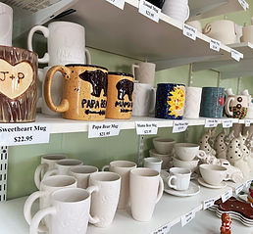


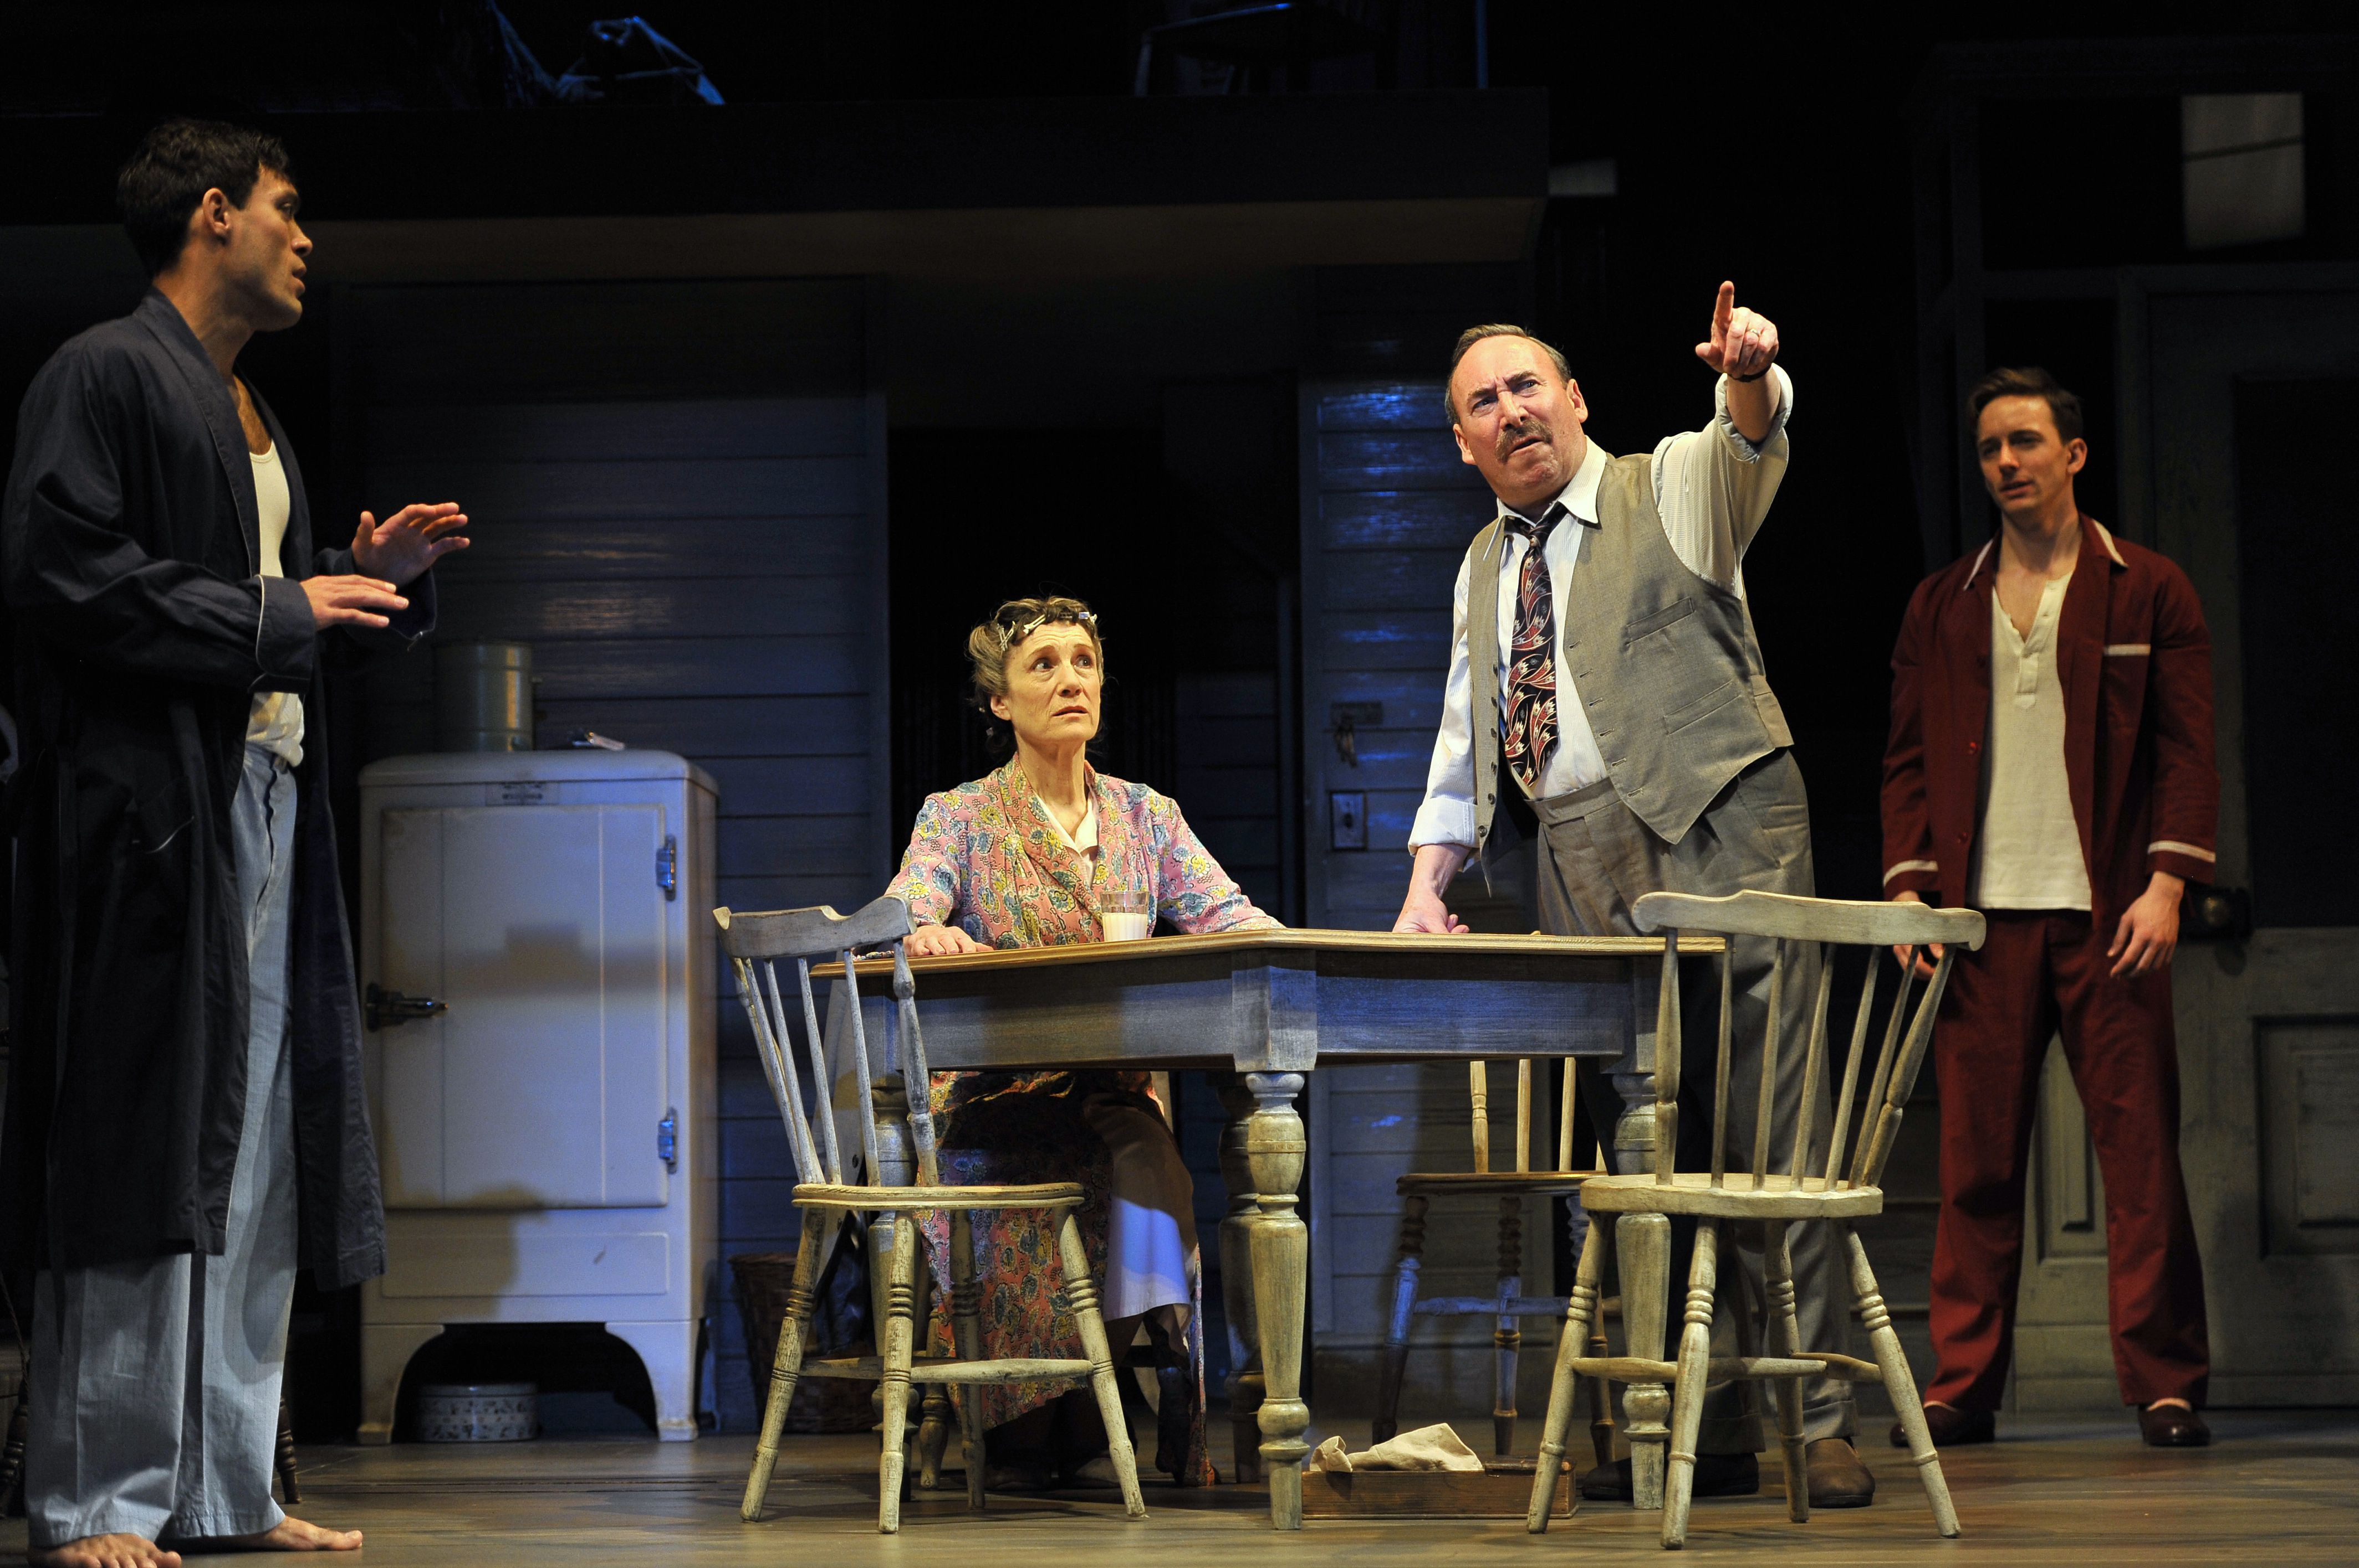
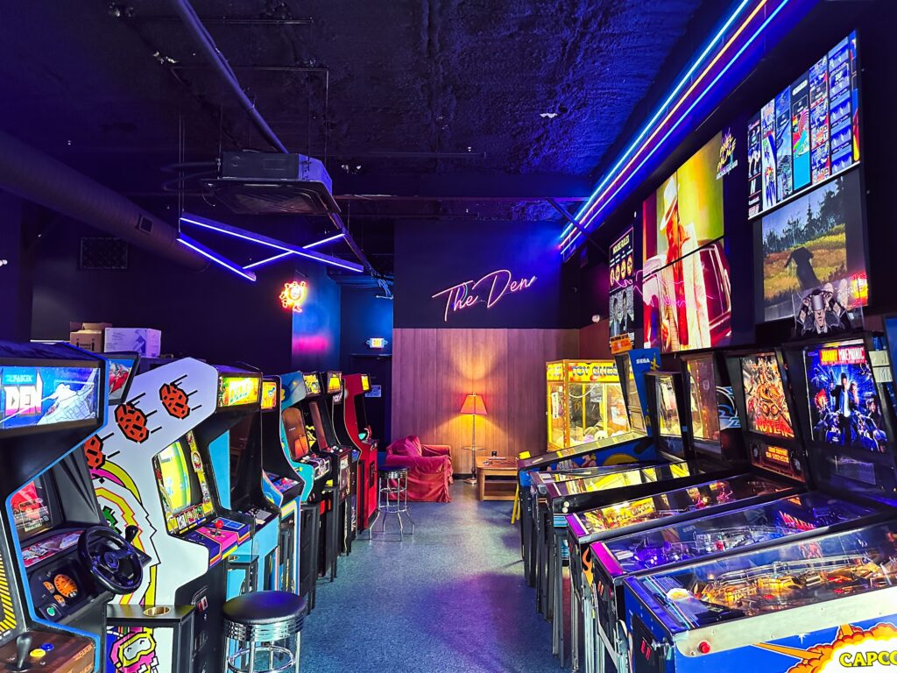
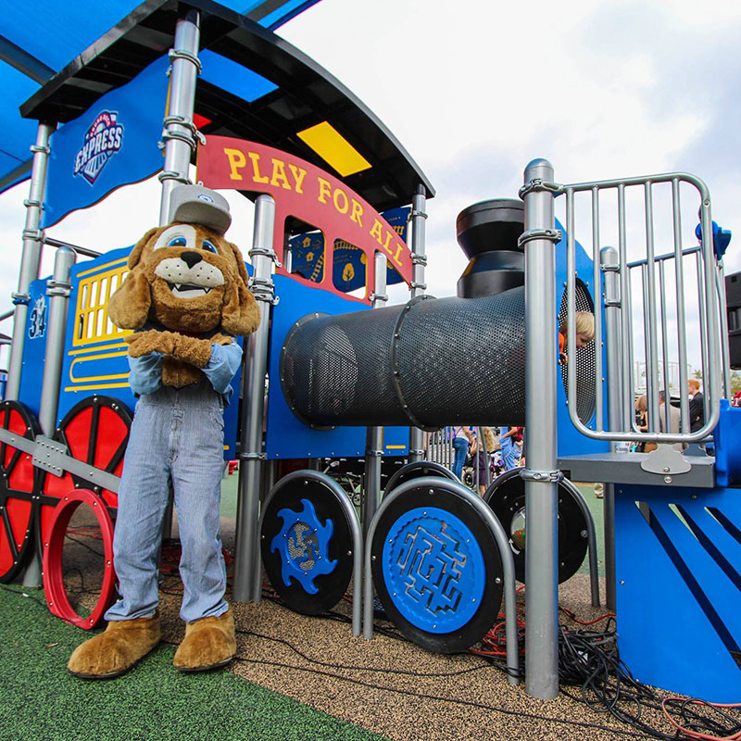
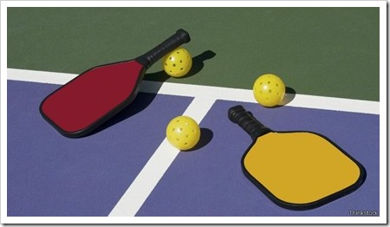
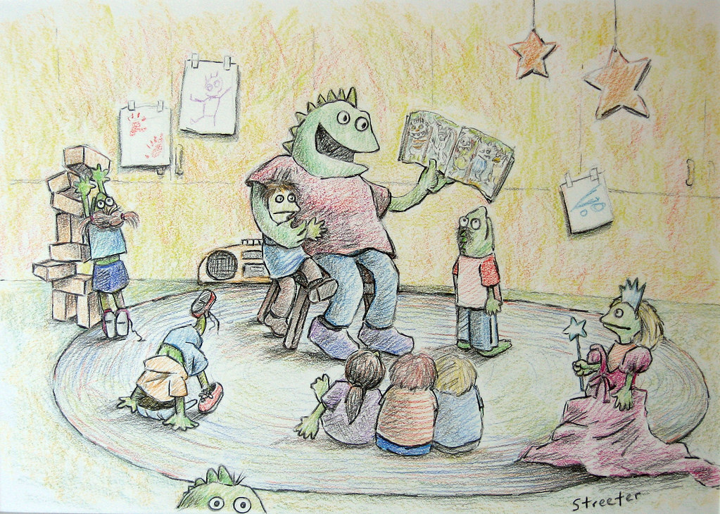

ATTRACTIONS
Board & Brush
1700 E Palm Valley Blvd #470
Round Rock, TX 78664
512-529-8658
https://boardandbrush.com/roundrock
Ceramic Lodge
18 Chisholm Trail Rd
Round Rock, TX 78681
512-248-2100
https://www.ceramiclodge.com/
The City Arts Center
216 E Main Street #101
Round Rock, TX 78664
512-218-7099
https://www.roundrocktexas.gov/city-departments/arts-and-culture/downtowner-gallery/
Escapology
2000 S I-35 Frontage Rd E2
Round Rock, TX 78681
512-487-7306
https://www.escapology.com/en/austin-tx/
Penfold Theatre
2120 N Mays St
Round Rock 78664
512-850-4849
https://www.penfoldtheatre.org/
Play for all Abilities Park
151 N AW Grimes Blvd
Round Rock, TX 78664
512-218-5540
https://play4all.org/
The Picklr
3021 S I-35 Frontage Rd #240
Round Rock, TX 78664
737-734-2225
https://thepicklr.com/location/round-rock/
Pixel Palace Arcade & Bar
2471 S. A.W. Grimes Blvd
Round Rock, TX 78664
https://pixelpalacearcade.com
Round Rock Library
200 E Liberty Ave
Round Rock, TX 78664
512-218-7000
https://www.roundrocktexas.gov/city-departments/library-home/
Rogues Gallery Comics & Games
1601 S I-35 Frontage Rd #330
Round Rock, TX 78664
512-279-8888
https://roguesgallerytx.com/
This Photo by Unknown Author is licensed under CC BY-NC-ND

Slide 3


